Slide 1
DATA LITERACY AND TABLEAU
Unveiling Market Insights: Analysing Spending Behaviour and Identifying Opportunities for Growth

Slide 2
TEAM PROFILE: NM;
Esaivanan.u - team leader
Inbathamizhan.s
Mohana.n
hari.s

Slide 3
INTRODUCTION
1.overview
Wholesaling or distributing is the sale of goods or merchandise to retailer to industrial, commercial, institutional or other professional businessman to other wholesalers (wholesale businesses) and related subordinated services. In general, it is the sale of goods in bulk to anyone, either a person or an organization, other than the end consumer of that merchandise. Wholesaling is buying goods in bulk quantity, usually directly from the manufacturer or source, at a discounted rate. The retailer then sells the goods to the end consumer at a higher price making a profit.

Slide 4
2.Propose
1. The goal is to provide a reliable and accurate prediction tool that assists users in navigating the Analysing Spending Behaviour and Identifying Opportunities for Growth
2. The model should identify the key features impacting the spending behavious and identifying the opportunities for growth

Slide 5
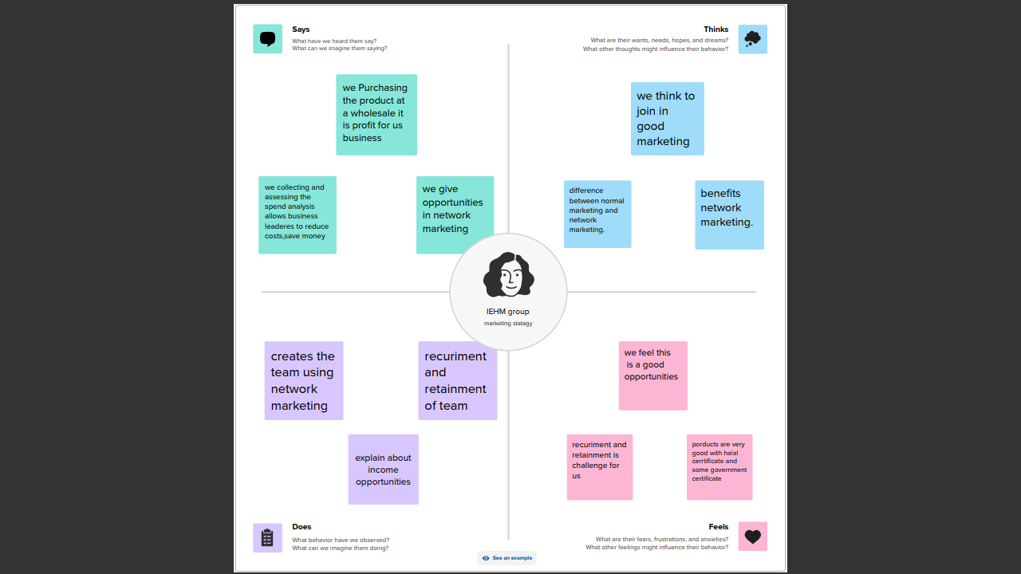
Problem defining and design thinking

Slide 6
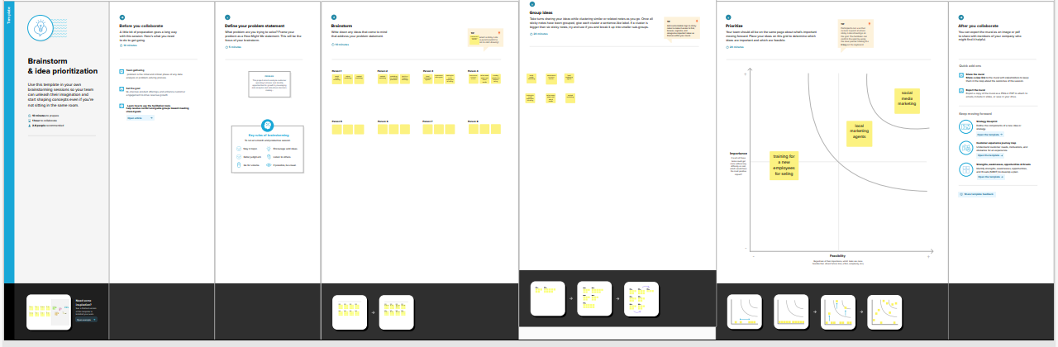
Brain storming map

Slide 7
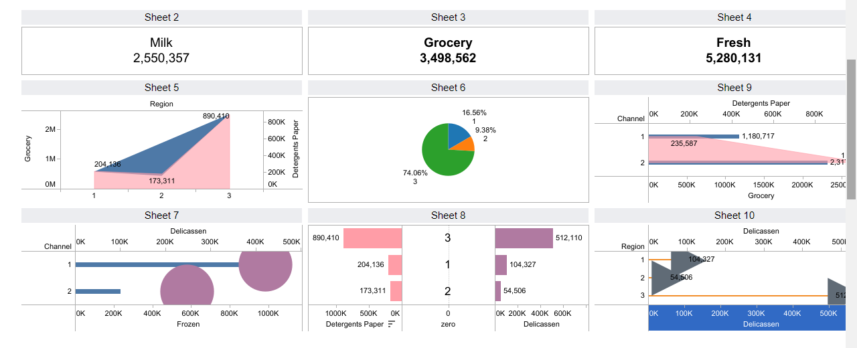
RESULT
Demo dashboard

Slide 8
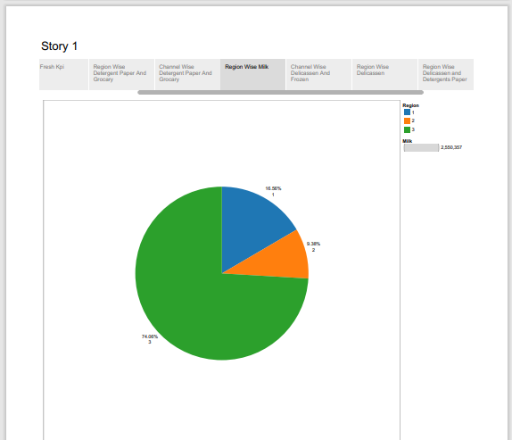
Story

Slide 9
Thank you

